Slide 1
Coreference Resolution
Natural Language Processing
(based on revision of Chris Manning Lectures)

Slide 2
Announcement
TA announcements (if any)...

Slide 3
Suggested Readings
https://web.stanford.edu/~jurafsky/slp3/21.pdf (coreference resolution)

Slide 4
Intro

Slide 5
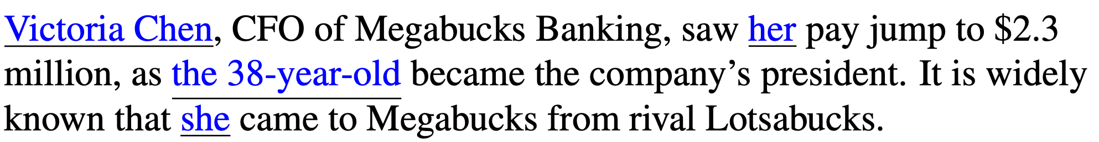
Coreference Resolution
Identify all mentions that refer to the same entity in the world
Each of the underlined phrases is referring to Victoria Chen. We called linguistic expressions like her or Victoria Chen mentions or referring expressions, and the discourse entity that is referred to Victoria Chen the referent. Two or more referring expressions that are used to refer to the same discourse entity are said to corefer; thus, Victoria Chen and she corefer.
In the coreference resolution algorithm, the output would need to find at least four coreference chains/clusters: {Victoria Chen, her, the 38 year-old, She}, {Megabucks Banking, the company, Megabucks}, {her pay}, {Lotsabucks}. Anything with single mentions is called Singleton.

Slide 6
Anaphora vs. Coreference vs. Entity Linking
Coreference is when two mentions refer to the same entity in the world
Chaklam loves deep learning. He plays soccer. Chaky also loves coding.
Chaky, He, Chaklam are said to corefer, where Chaklam is the referent
Coreference resolution find whether two mentions corefer
Anaphora is the reference in a text to an entity that has been previously introduced
Chaklam said he would give a quiz.
Chaklam is the antecedent, and he is the anaphor
Anaphora can or cannot be coreference
Every dancer twisted her knee.
Every dancer is the antecedent, and her is the anaphor. But they DO NOT corefer
Entity linking is the process of mapping a discourse entity to some real-world individual
Washington is at United States. Does Washington mapped to George Washington or State of Washington?
Coreference resolution and entity linking can work together in a NLP pipeline

Slide 7
Coreference Resolution
Clearly, coreference resolution is an important criteria for successful NLP tasks such as question-answering, translation, dialogue and much more…
Dialogue
“There is a 2pm flight on United and a 4pm one on Cathay Pacific”
User said in chatbot: “I want the second one”
Question answering
Context: “Chaky loves deep learning. He is born in Hong Kong”
Question: Where is Chaky born?

Slide 8
Coreference Tasks and Datasets

Slide 9
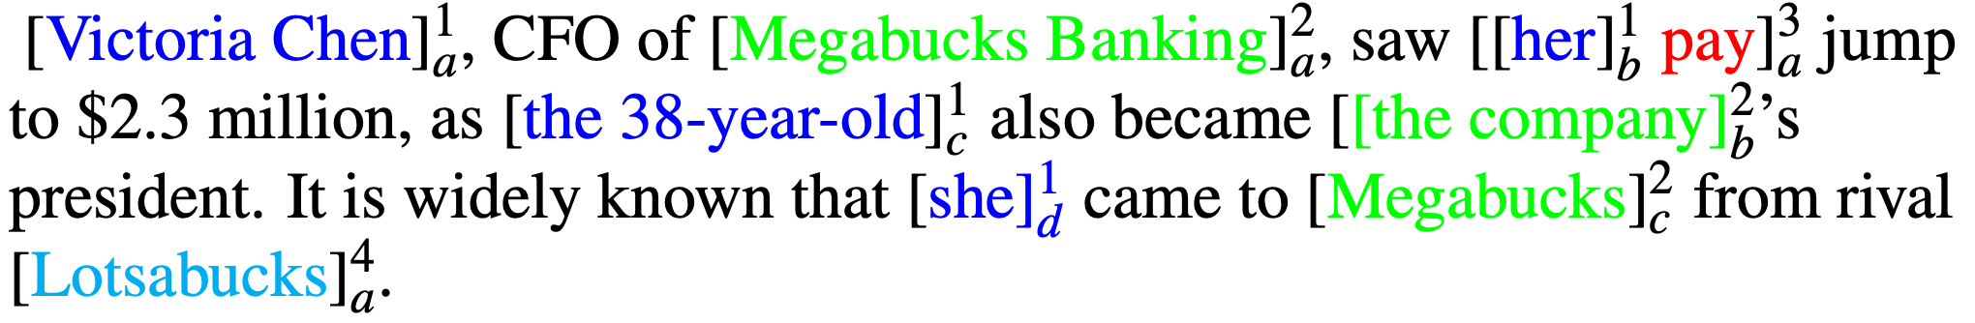
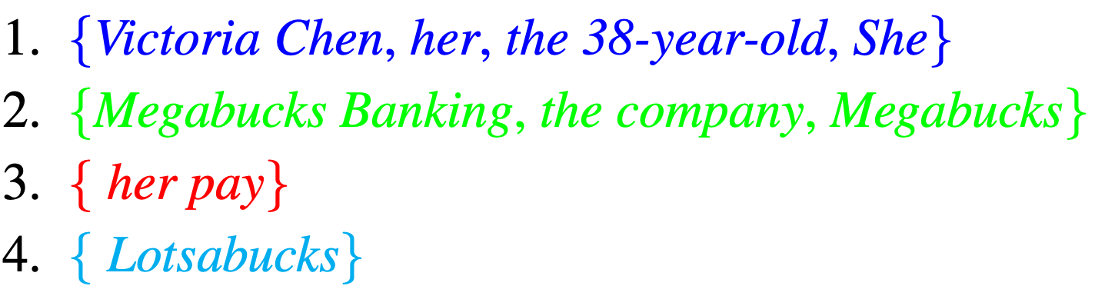
Coreference Resolution Task
Given a text T, find all entities and the coreference links between them
The output could be (many variants):

Slide 10
Coreference Resolution Task
What is counted as mention and what links are annotated differ from task to task and dataset to dataset
Some datasets do not label singletons, making the task easier
OntoNotes contains hand-annotated Chinese and English coreference datasets of roughly one million words each, consisting of newswire, magazine articles, broadcast news, etc., as well as 300,000 words of annotated Arabic newswire
Does not label singletons
Some tasks use gold mention-detection, i.e., the system is given human-labeled mention boundaries and the task is just to cluster these gold mentions
Eliminates the need to detect and segment mentions from running text

Slide 11
Mention Detection

Slide 12
Mention Detection
Obviously, the first stage of coreference is mention detection
Find the spans of text that constitute each mention
Many traditional NLP works well:
Pronouns:
Use a POS tagger
Named entities
Use a NER system
Noun phrases
Use a parser (constituency parser - next week!)
A neural model like BERT masking mention span would also work well
Not as easy as you think
Every student, No student, The best donut in the world, 100 miles
Solution: After coreference resolution, discard all singletons

Slide 13
Coreference Algorithms

Slide 14
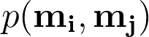
Method 1: Mention-Pair
Simplest and most influential
Based around a classifier, in which given a pair of mentions, i.e., a candidate anaphor, and all potential antecedents, and makes a binary classification whether they are coreferring or not:
For positive examples, p is near 1, for negative samples, p is near 0
Given this example, and let say we are currently working on “she” as the anaphor candidate.
“I voted for Nader because he was most aligned with my values,” she said.
I
Nader
he
my
she

Slide 15
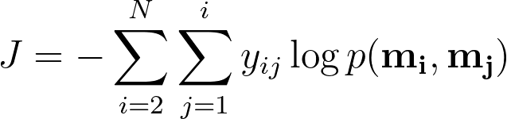
Method 1: Mention-Pair Training
N mentions in a document
y_{ij}= 1 if mentions m_{i} and m_{j} are coreference, -1 if otherwise
Just train with regular cross-entropy (note that it is simply binary logit loss…)
Coreferent mentions pairs should get high probability, others should get low prob
Iterate through mentions
Iterate through candidate antecedents (previously occurring mentions)

Slide 16
Method 1: Mention-Pair Test Time
On inference, pick some threshold (e.g., 0.5) and add coreference links between mention pairs where is above the threshold
Take the transitive closure to get the clustering
I
Nader
he
my
she
I
Nader
he
my
she

Slide 17
Method 1: Mention-Pair Disadvantages
Clear advantage is simplicity, but has one main problem
Does not directly rank candidate antecedents to each other, so it’s not trained to decide, between two likely antecedents, which one is in fact better

Slide 18
Method 2: Mention Ranking
Assign each mention its highest scoring candidate antecedent according to the model
Dummy NA mention allows model to decline link the current mention to anything (“singleton” or “first” mention)
“I voted for Nader because he was most aligned with my values,” she said.
NA
I
Nader
he
my
she
best antecedent for she?

Slide 19
Method 2: Mention Ranking
Assign each mention its highest scoring candidate antecedent according to the model
Dummy NA mention allows model to decline link the current mention to anything (“singleton” or “first” mention)
“I voted for Nader because he was most aligned with my values,” she said.
NA
I
Nader
he
my
she
p(my, she) = 0.2
p(he, she) = 0.1
p(Nader, she) = 0.1
p(I, she) = 0.5
p(NA, she) = 0.1
calculate the softmax prob

Slide 20
Method 2: Mention Ranking
Assign each mention its highest scoring candidate antecedent according to the model
Dummy NA mention allows model to decline link the current mention to anything (“singleton” or “first” mention)
“I voted for Nader because he was most aligned with my values,” she said.
NA
I
Nader
he
my
she
p(my, she) = 0.2
p(he, she) = 0.1
p(Nader, she) = 0.1
p(I, she) = 0.5
p(NA, she) = 0.1
Only add the highest scoring coreference link

Slide 21
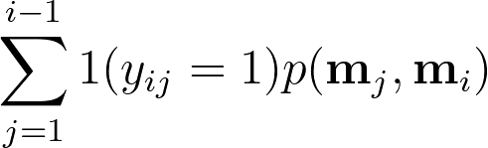
Method 2: Mention Ranking
Mathematically, we want to maximize this probability:
…we want the model to assign a high probability
For ones that are coreferent to m_{j}
Iterate through candidate antecedents (previously occurring mentions)

Slide 22
How do we compute the probabilities?
For both mention-pair and mention ranking, there is a probability term that we have to compute. We can compute using three main ways:
A non-neural statistical classifier (use features)
Simple neural network
More advanced model using LSTMs, attention, transformers

Slide 23
Coreference Algorithms

Slide 24
A non-neural statistical classifier
What features to use?
Person/Number/Gender agreement
Jack gave Mary a gift. She was excited.
Semantic compatibility
… the mining conglomerate … the company …
Certain syntactic constraints
John bought him a new car. [him can not be John]
More recently mentioned entities preferred for referenced
John went to a movie. Jack went as well. He was not busy.
Grammatical Role: Prefer entities in the subject position
John went to a movie with Jack. He was not busy.
Parallelism:
John went with Jack to a movie. Joe went with him to a bar.
…

Slide 25
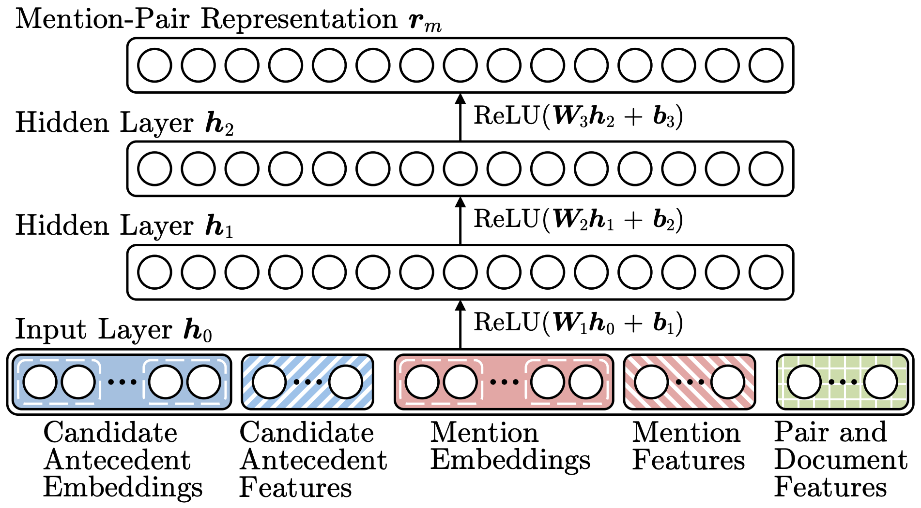
2. Neural Coref Model [Clark and Manning, ACL 2016]
Standard feed-forward neural network (uses mention-pair)
Input layer: word embeddings and a few categorical features
concatenation
Improving Coreference Resolution by Learning Entity-Level Distributed Representations, Clark and Manning 2016, https://arxiv.org/pdf/1606.01323.pdf

Slide 26
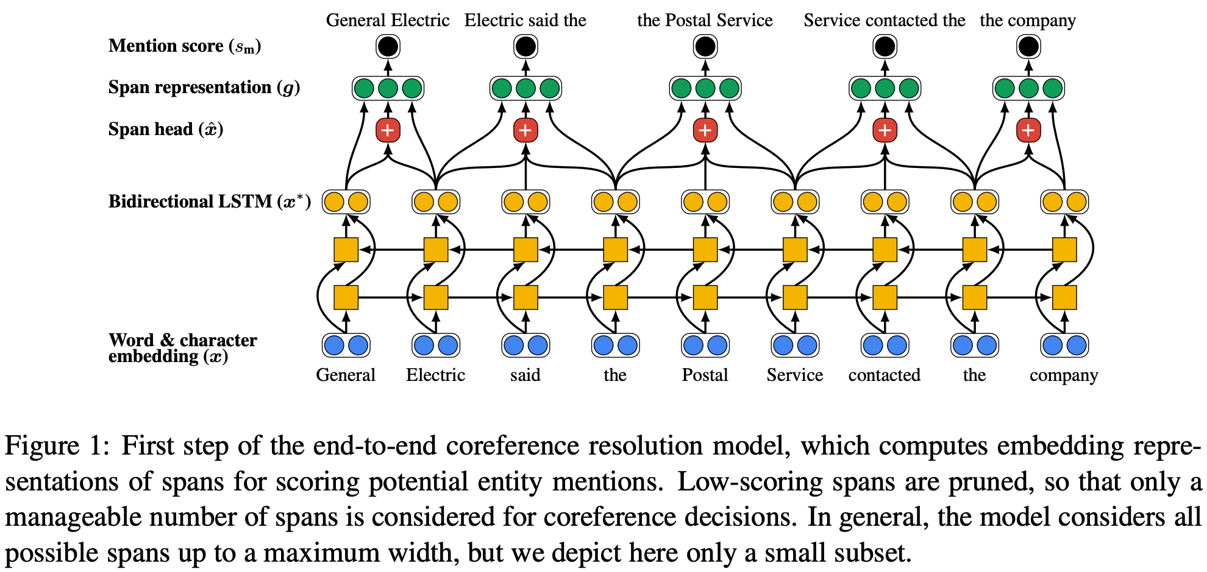
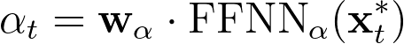
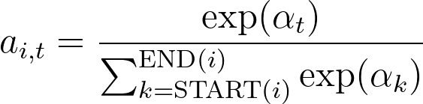
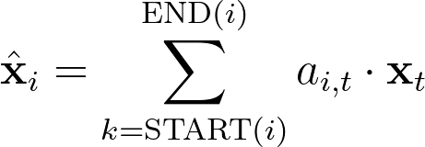
3. End-to-end Neural Coref Model [Lee et al., EMNLP 2017]
biLSTM to learning the representations; consider every span of text (uses mention-ranking)
additional
features
Span representation for “the Postal Service”:
Attention-based representation of the span words (i.e., the Postal Service)
End-to-end Neural Coreference Resolution, Lee et al. 2017,, https://arxiv.org/pdf/1707.07045.pdf

Slide 27
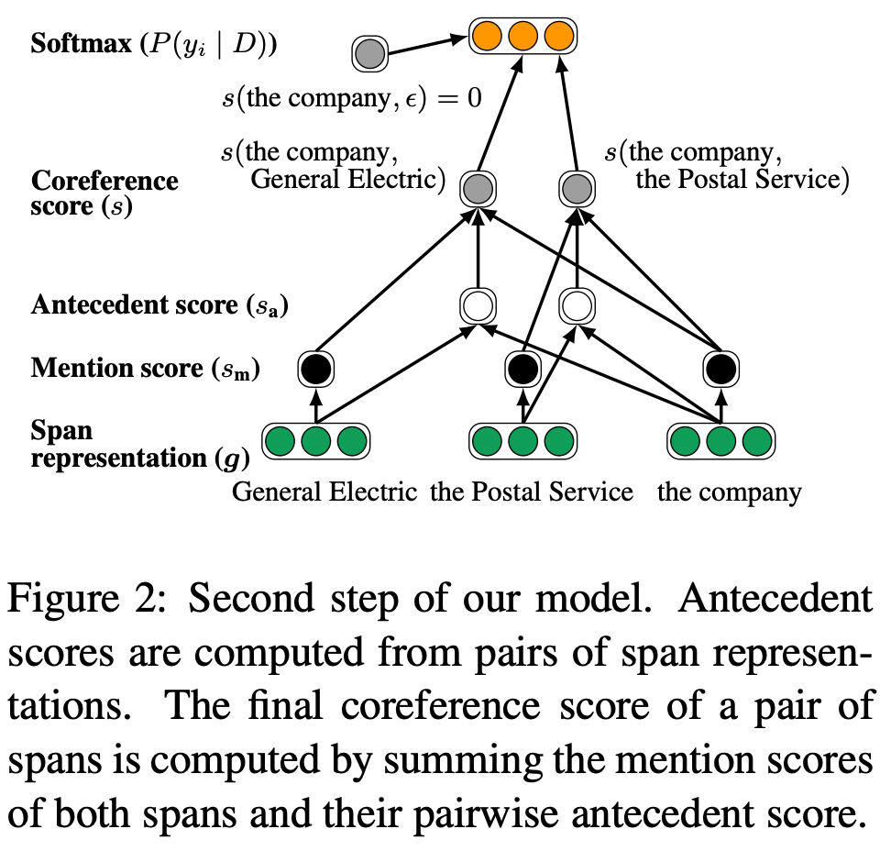
3. End-to-end Neural Coref Model
Lastly, score every pair of spans to decide if they are coreferent mentions
Are spans i and j coreferent mentions?
Is i a mention?
Is j a mention?
Do they look coreferent?
Multiplicative interactions between the representations
Extra features

Slide 28
3. End-to-end Neural Coref Model
Main problem
Very computationally expensive to consider every spans
Solution
Prune some spans that are not likely a mention

Slide 29
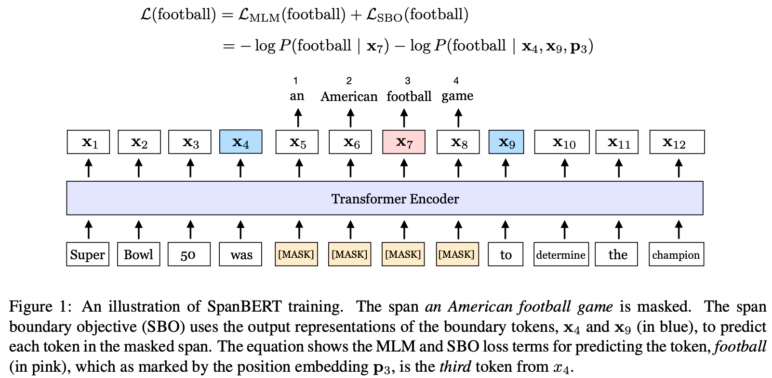
4. BERT-based coref [Joshi et al., ACL 2019]
SpanBERT: pretrains BERT using span masking techniques so it can perform well on span-based tasks such as coref or QA
SpanBERT: Improving Pretraining by Representing and Predicting Spans, Joshi et al. 2019, https://arxiv.org/pdf/1907.10529.pdf

Slide 30
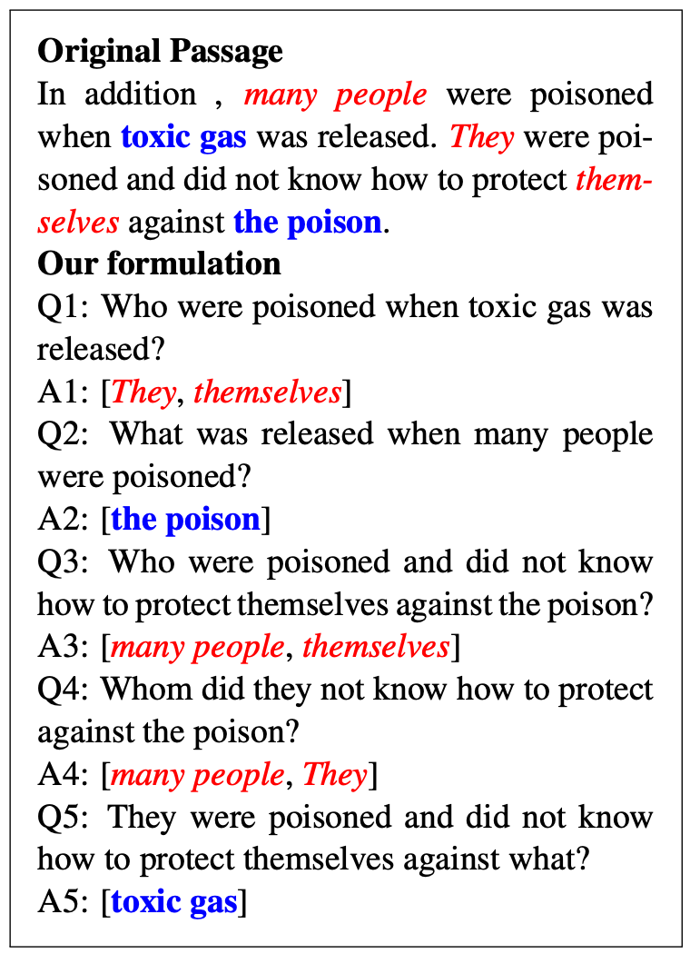
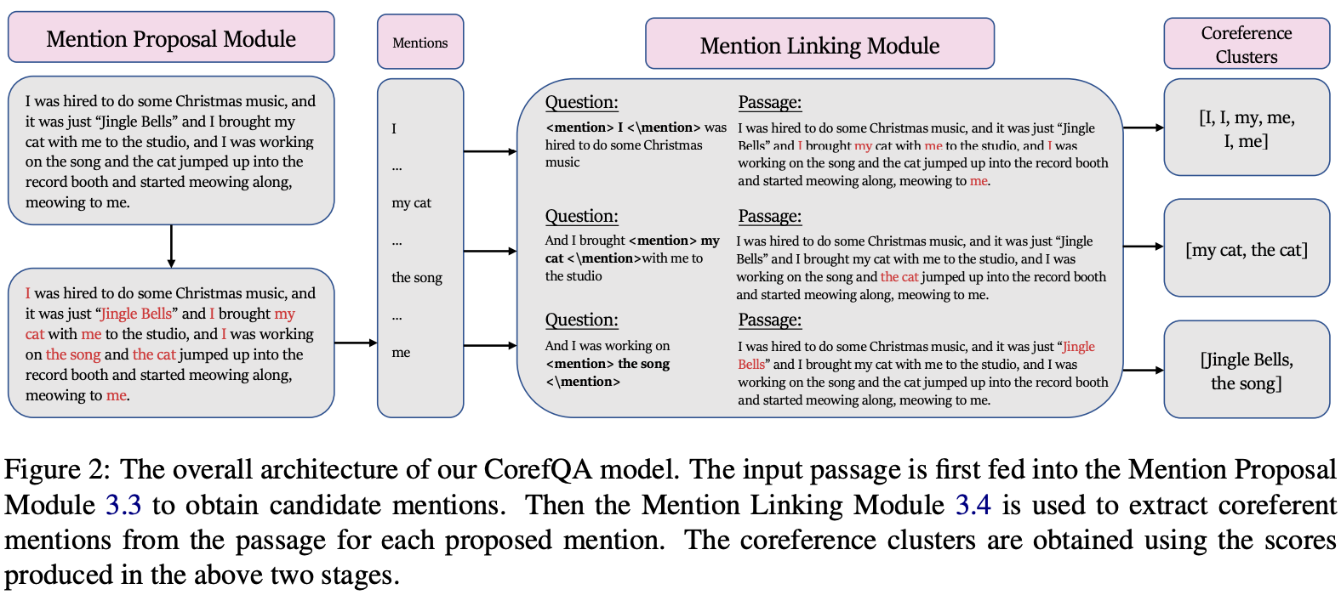
4. BERT-based coref [Wu et al., ACL 2020]
CorefQA: treats coreference as QA
CorefQA: Coreference Resolution as Query-based Span Pediction, Wu et al. 2020, https://aclanthology.org/2020.acl-main.622.pdf

Slide 31
Evaluation

Slide 32
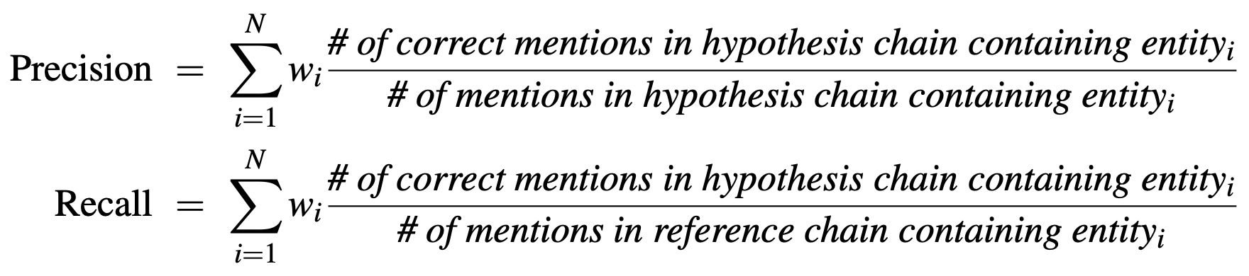
Evaluation
Essentially a clustering problem
For each mention, compute a precision and a recall
We evaluate by comparing a set of hypothesis chains or clusters H, against a set of gold or reference chains R or clusters from human labeling

Slide 33
Coref Performance
Evaluated on CoNLL-2021 shared task (based on OntoNotes we mentioned earlier). The average F1 of MUC, B³, and CEAF (all basically based on H and R) and is used.
Model | English | Chinese
Lee et al. (2010) - Rule-based | 55 | 50
Clark and Manning (2016) - neural coref model | 65.4 | 63.7
Lee et al. (2017) - end-to-end neural coref model | 67.2 | -
Joshi et al. (2019 - SpanBERT | 79.6 | -
Wu et al. (2020) - corefQA | 83.1 | -

Slide 34
Summary
Coreference is a useful, challenging, and linguistically interesting task
Main dataset is OntoNotes and CoNLL shared task
Two clustering algorithms: mention pair and mention clustering
Many ways to compute probabilities
Feature-based - require a lot of manual labor
Neural-based - still seems requiring some additional features
BERT-based - masking seems to greatly improve; does not require features
Systems are getting better but most models still make many mistakes
OntoNotes coref is pretty easy, because it’s based on news
Imagine a novel or actual complicated how-to instructions

